Slide 1

Continuous Integration for a Node.js Proxy using Cloud Tools
Rakesh Talanki
Apigee Principal Architect

Slide 2

Introduction and Agenda

Slide 3
Agenda
Set up Continuous Integration for API’s using Cloud Tools
1. |  | Set up Node.js API in Apigee | 8.00
2. |  | Build API scaffolding with Yeoman | 15:00
3. |  | Use Grunt to build and deploy | 10:00
4. |  | Use Git for Source Control | 5.00
5. |  | Test using Postman | 10:00
6. |  | Test using Mocha, Chai and Nock | 10:00
7. |  | API Documentation | 5:00
8. |  | Use Travis to set up CI | 30:00
Notes:
So, what are going to talk about today?
How did we get here?
We’re going to provide a little bit of context around phases of the build process
Specifically, how build can quickly spin out of control and some of the techniques that developer teams can use to mitigate risks of build hell
realize the importance of the life cycle, so you can continuously improve it, by eliminating waste (gaining 5% of efficiency)
Section 1:
So, in section #2 we’ll try to address the challenges by providing you with the tools to manage the lifecycle
So, we’ll cover from basic to more advanced tools and techniques
And explaining their differences
Section 2:
We will cover complementary tools that address other phases of the lifecycle
Take it to the next level:
- I'm going to try to bring most of the techniques talk how to bring everything home
Functional Testing:
- Tools that you have a available for functional testing

Slide 4
Getting ready
Apigee Free Account
NPM and Node.js - https://goo.gl/080g8Q
Git (optional) - https://goo.gl/rTyIvP
Github Free Account – http://www.github.com
Apigee Free Account on Cloud
Travis Account (free)- https://travis-ci.org/

Slide 5
There must be a way to automate all of tedious work!
Clean API Bundle Files and Folders
Package phase
Copy Artifacts
Configure phase
Configure Artifacts for each environment (DEV, QA, STG, PROD, etc.)
Package Artifacts (zip)
Install phase
Deactivate last revision from the API Services
Import and deploy API bundle to API Services
Execute Unit Tests
Execute Functional Tests
Execute Performance Tests
Deploy and Test Documentation on CMS
Any other manual tasks…
5
Notes:
Look at all of the tasks required to support the API Lifecycle

Slide 6


Emphasis slide
Before
After

Slide 7
Continuous Integration
Development
SCM
Build
SIT
UAT
Prod
Continuous Integration (CI) is the practice, in software engineering, of merging all developer working copies with a shared mainline several times a day
Notes:
What is CI and what are its principles?
Continuous integration (CI) is the practice, in software engineering, of merging all developer working copies with a shared mainline several times a day
It was first named and proposed as part of extreme programming (XP)
Its main aim is to prevent integration problems, referred to as "integration hell”
Good reads… The Phoenix Project by Gene Kim, Continuous Delivery by Jez Humble

Slide 8

CI: The Volkswagen Approach
We master Emission Test Results with Software
Then, we detect when our tests are being run in a CI server, and make them pass.*
*https://github.com/auchenberg/volkswagen

Slide 9
Building a CI Environment

Slide 10
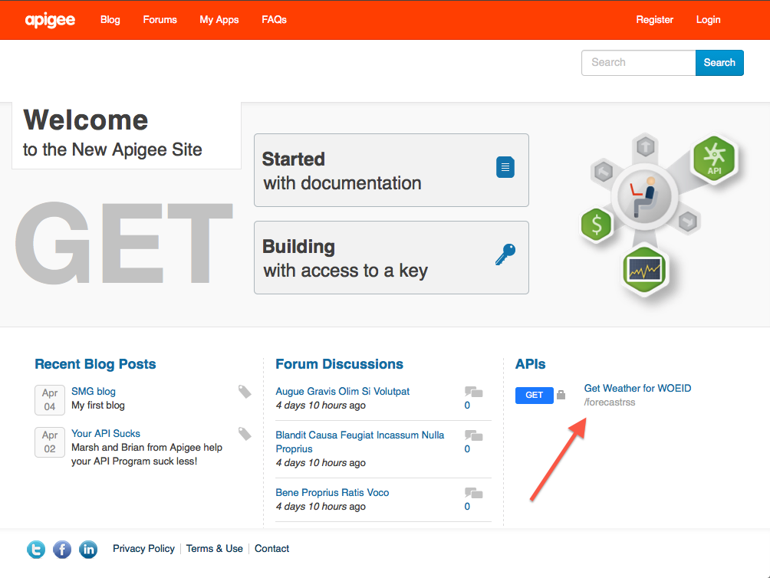


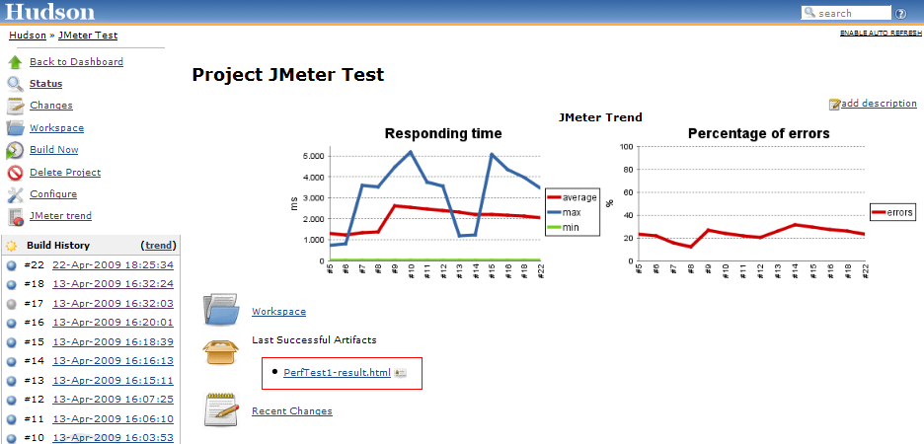

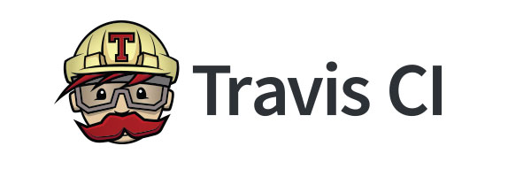






CI: The Process
Update Docs
Dev Team
Publish Reports
Source Code
Run Unit, Functional, and Performance Tests
Continuous Integration
Version Control
Deploy API Bundle
Pull Request or Merge
Code coverage analysis
API Job is triggered
Static Code Analysis

Slide 11
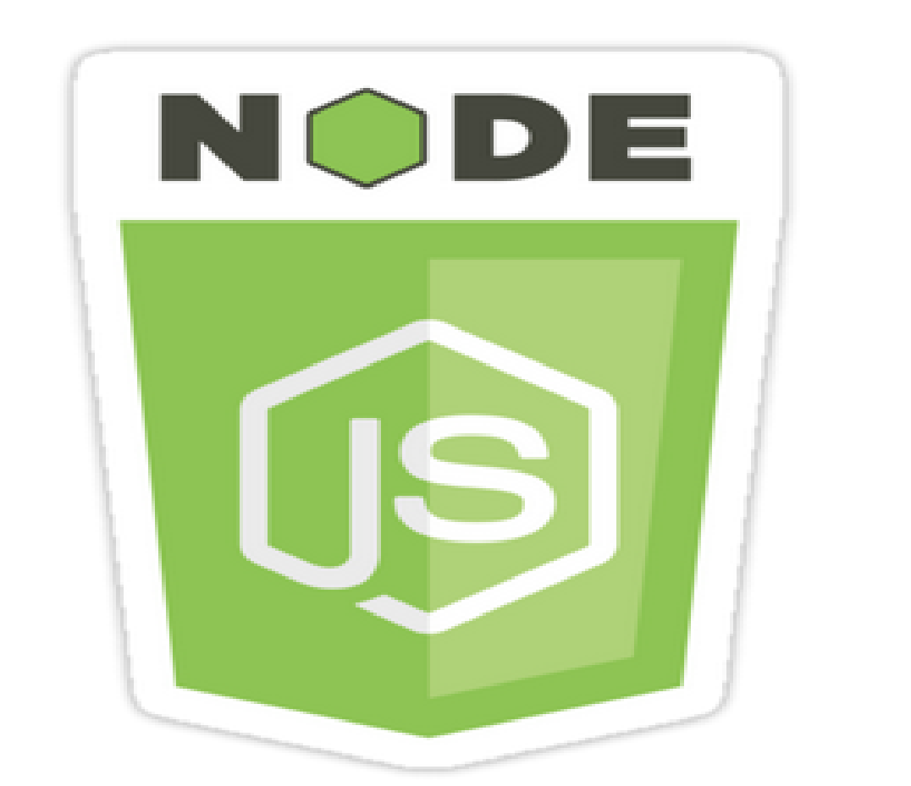

Step 1: Build an API Proxy
API
Notes:
Build an API Proxy
Use Yeoman to build a starter node.js API Proxy
This is called API Scaffolding

Slide 12
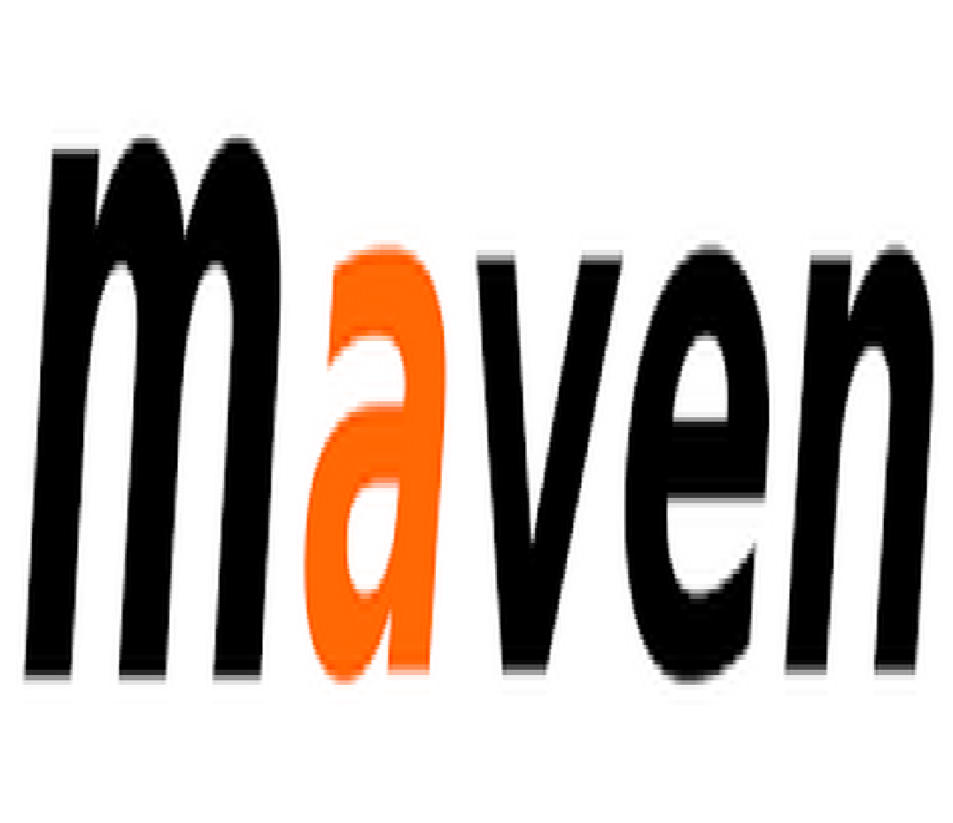

Step 2: Decide on a Build Tool

Slide 13
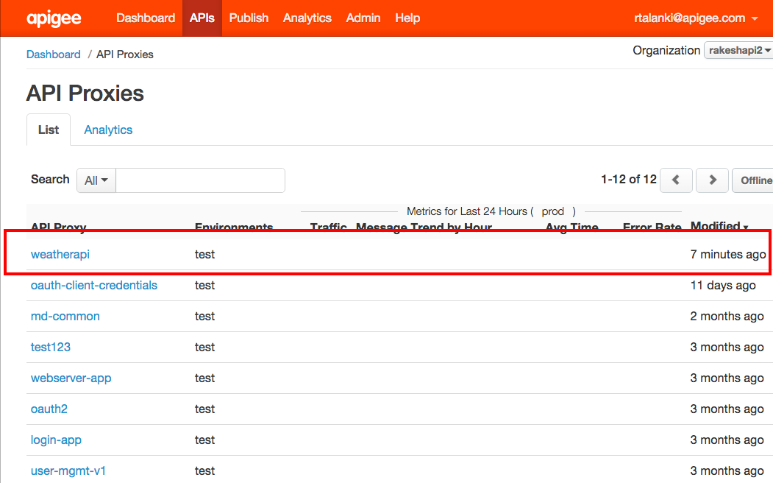
Step 3: Deploy to Apigee on Public Cloud

Slide 14

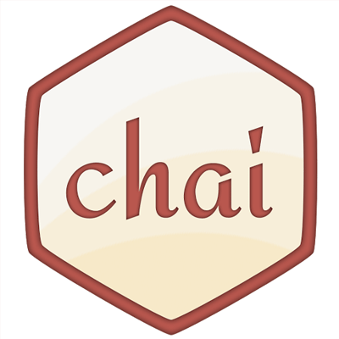

Step 4: Run Local Tests

Slide 15


Step 5: Use a CI Tool

Slide 16
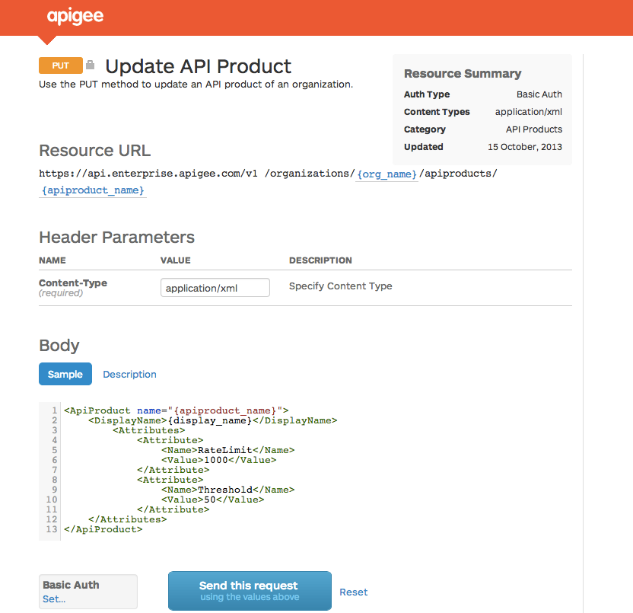
Step 6: Generate Interactive Documentation

Slide 17
Hands-on
Putting it all together: Continuous Integration

Slide 18

API Proxy Scaffolding Generator
Gets you started with starter API Proxy
Standardizes naming conventions by generating policies and other artifacts
Based on Yeoman, so it can extended for other tools, not only Grunt, but also Maven

Slide 19
API Proxy Scaffolding Generator
Let’s try it!
Install Npm and Node: Open http://nodejs.org in a browser and click Install.
Check: node --version
Upgrade Node to 0.10.35 or higher:
npm cache clean
npm update –g
Install yeoman: npm install –g yo
Install Grunt: npm install –g grunt-cli
Install Grunt plugin: npm install -g generator-apigee-deploy-grunt-api
Run yo: yo apigee-deploy-grunt-api
http://goo.gl/lSZrth

Slide 20
Build and Deploy

Slide 21
Grunt or Maven?
Apigee Deploy Grunt Plugin
TDD Ready - Mocha, Jasmine, Karma, any JS test framework and even Jmeter
Supports code review - with JSHint and ESLint – cyclomatic complexity
Supports Configuration Management - Search and replace based on XPath and RegExp
Supports node.js remote deployment and Java Policies
Plays well with CI (Continuous Integration) – Jenkins, Travis, Go, Bamboo, etc.
Supports reusable policies via search and replace files and Git Submodules
It’s way easier to customize via Grunt Custom Tasks
Apigee Deploy Maven Plugin
Test based on JMeter
Config Management - Search and replace based on Xpath
Plays well with CI – Jenkins mostly. Nice looking reports
Supports node.js remote deployment and Java Policies
Supports reusable policies via Supports Proxy Dependency Maven Plugin
Notes:
Pick one that is comfortable for you.

Slide 22

Grunt API Lifecycle Management Plugin
Easy and flexible
It’s Node! NPM
Compatible with CI
https://github.com/apigeecs/apigee-deploy-grunt-plugin
Follow steps from README.md
Plays well with TDD frameworks
Empowers the developer to apply continuous improvement to the lifecycle
Notes:
Demo with no skipTests arguments
Notice passing username and password as environment variables. You don’t want to expose your credentials storing them in you source control repository
Notice I passed –Dorg=testmyapi, in case you want to target an organization different than the default one specified in pom.xml
Config.json to be explained in the next steps
Tests with Jmeter to be explained in the next steps

Slide 23
Grunt API Lifecycle Management Plugin
Configuration Management - apigee-config.js
exports.xmlconfig = function(env, grunt){ config = { "test" : [ { "options": { "xpath": "//APIProxy/Description", "value": "<%= grunt.option('gitRevision') %>" }, "files": { "target/apiproxy/<%= apigee_profiles[grunt.option('env')].apiproxy %>.xml": "apiproxy/*.xml" } }, { "options": { "xpath": "//TargetEndpoint/HTTPTargetConnection/URL", "value": "https://weather.yahooapis.com/forecastrss" }, "files": { "target/apiproxy/targets/default.xml": "apiproxy/targets/default.xml" } }, { "options": { "xpath": "//ProxyEndpoint/HTTPProxyConnection/BasePath", "value": "/weathergrunt" }, "files": { "target/apiproxy/proxies/default.xml": "apiproxy/proxies/default.xml" } } ],
Notes:
Demo with no skipTests arguments
Notice passing username and password as environment variables. You don’t want to expose your credentials storing them in you source control repository
Notice I passed –Dorg=testmyapi, in case you want to target an organization different than the default one specified in pom.xml
Config.json to be explained in the next steps
Tests with Jmeter to be explained in the next steps

Slide 24
Why choose Apigee’s Maven?
More time to focus on what really matters by automating repetitive tasks
Innovation ready. Extensible plugin-based platform
Promotes productivity. Promotes usage of CLI (Command-Line Interface). No need for IDEs
Easy to adopt. No need of CLI. Eclipse IDE Support through M2E and IntellijIDEA, WebStorm
Easy to configure and to track changes. All of its artifacts can live in version control as text files
Multilanguage support. One JVM to rule them all (Ruby, Jython, JavaScript, Groovy, Scala) or even Shell scripts
Tens of Thousands plugins ready in Maven Central
Backed up by Apigee and the open source community
Notes:
This way the API Team can build more awesome features, faster, better and stronger
This can only be achieved by releasing your developers from repeatable tasks and allowing them to work on tasks that aren't human replaceable

Slide 25
Hands-on
Putting it all together: Continuous Integration

Slide 26
Grunt
Deploy to Apigee
grunt --env=test --username={apigee_edge_email_address} --password={apigee_edge_password} --debug --curl=true --upload-modules
Use apigee gateway and with Yahoo Weather standard Target
https://{org-env}.apigee.net/{api-basepath}/apigee/forecastrss?w=2502265
Use apigee gateway calling Yahoo Weather through Apigee Node.js as Target
https://{org-env}.apigee.net/{api-basepath}/apigee/forecastweather_node?w=2502265
Let’s try it! http://goo.gl/lSZrth

Slide 27
Testing

Slide 28

Testing
Grunt Tests with Mocha and friends http://goo.gl/xHLzSh
TDD (Test Driven Development) for APIs
Faster to write than BDD (Behavior Driven Development)
Mocha Testing Framework, Chai for Assertions
describe('Check weather in cities', function() { async.each(weatherData.simpleWeatherArray() , function(cityData, callback) { it('you should be able to get forecast weather for ' + cityData.name + ' from this API Proxy.', function(done) { var options = { url: cityData.url, //'https://testmyapi-test.apigee.net/weathergrunt/apigee/forecastrss?w=2502265', headers: { 'User-Agent': 'request' } } request(options, function (error, response, body) { expect(body).to.contain(cityData.name) //Sunnyvale, Madrid assert.equal(cityData.responseCode, response.statusCode) done() }) }) callback(); }); });
Notes:
If you notice, we’re using the same command that was used prior when running maven install for deployment. Except that we’re enabling a new plugin in the process to resolve fragments into actual code

Slide 29

Testing
POSTMAN
Postman an API Testing tool
Very widely used by Developer and Tester community
Add Jetpacks - They are awesome $9 upgrades

Slide 30
Testing
POSTMAN with Newman
Newman
A command-line collection runner for Postman.
It allows you to effortlessly run and test a Postman collection
Can be Integrated with your build tools like Maven/Grunt and make it part of your CI build
https://www.getpostman.com/docs/newman_intro

Slide 31
Testing
JMeter
Get examples https://github.com/apigee/apigee-deploy-maven-plugin
Use assertions to
Validate response codes
Validate payload content
Validate schemas (JSON – DRAFT04)
Validate response times. Spot network latency and performance issues

Slide 32
Mocks with Nock
Promotes CDC (Consumer-Driven Contract)
Promotes faster development
No backend? No problem
Issues with starting development without a contract in place:
There’s no formality, downstream systems changes, no one knows! ☹
Downstream systems can run tests to verify whether they’re breaking the contract
There’s a backend? No problem
Nock can record request and response objects
Request/response: content, headers, status codes, delay, etc.

Slide 33
Demo
Putting it all together: Continuous Integration

Slide 34
POSTMAN/Newman
Let’s try it!
Goto Postman and Create a collection of tests
Download your collection
Install newman: npm install -g newman
Run your collection: newman -c mycollection.json
Run your collection 10 times: newman -c mycollection.json -n 10

Slide 35
Mocha/Chai
Adding Tests
Add to tests/weatherapi.js
Adding Data Driven Tests
If your tests need data that can be fetched via XHR, stick a .json file in the data directory, you can access it at /data/<filename>.json.
Let’s try it!
http://goo.gl/pDxzYG

Slide 36
Source Code Management

Slide 37
SCM
Define your branching and merging strategy from the get go
Opt for a scalable model
Single Repo vs. Multiple Repos
Communicate and provide feedback through pull requests (aka. social coding)
Apply CI and avoid big bang merges
Practice, practice, practice

Slide 38
SCM
What can be managed in SCM?
API Artifacts
API proxy source code (XML, JS, Java, Python, binaries, etc.)
API Documentation (Markdown, HTML)
Testing Artifacts
Scripts
Data
Configuration, Deployment and management scripts
Management API requests to create entities like target servers and data stores
Configuration Data
Keep sensitive data out of SCM

Slide 39

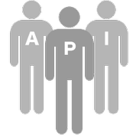

Source code management: “Fork-and-pull” model
1
Fork repository
Issue pull request
5
Deploy to test
Deploy to production
2
4
Committers
7
8
Clone to workstation
Commit to clone repository
6
Development Environment
Testing Environment
Production Environment
Deploy and test
3
Developer Workstation

Slide 40
Summary
Identify benefits of SCM
Apply fork and pull requests
Learn SCM models pros and cons
Monolithic vs Single and Multiple Repos
Identify SCM branch types and how to use them
Apply merging

Slide 41
Continuous Integration

Slide 42
Continuous Integration
Principles
Maintain a code repository
Automate the build
Make the build self-testing
Keep the build fast
Make it easy to get the latest deliverables
Everyone can see the results of the latest build
Automate deployment

Slide 43
The Full Circle
Update Docs
Dev Team
Publish Reports
Source Code
Run Unit, Functional, and Performance Tests
Continuous Integration
Version Control
Deploy API Bundle
Pull Request or Merge
Code coverage analysis
API Job is triggered
Static Code Analysis

Slide 44
Continuous Integration and Deployment
API Lifecycle
Tooling: Jenkins and Travis
Connect to a Git Repo
Leverage
Maven Plugin
Grunt
Reap Your Benefits!!!
Makes it visible and measurable!!!
Faster to Market!!!
Save on Maintenance $$$!!!
Notes:
First-Time setup and get to the source
You had your first encounter with the Apigee Plugin by first setting up your environment and cloning the github repo
As we tested there were zero dependencies with private repos
Start with the right API structure
To identify the key elements of the API bundle and where they reside in the folder structure
So, you can follow best practices by defining the API structure from the get go. Since you’re going to use continually use this structure for multiple APIs, eventually you’ll implement more API bundles and troubleshoot them, so it highly recommended to become intimately familiar with it.
Introduced share-pom.xml to provide an example of aggregation in terms configuration, by declaring common configuration in a single place
We also introduced API pom.xml
Apply inheritance
To avoid duplication and better maintainability

Slide 45
Demo
Putting it all together: Continuous Integration

Slide 46
Travis Integration
If you do not have git installed, then
Fork my repository https://github.com/rakeshtl/CI-Travis.git
If you have git installed, then
Create New Public Repository - https://github.com/new
Goto your directory and run the following commands
Npm install –g git
git init
git add .
git commit -m "first commit"
git remote add origin https://github.com/{....} (eg. https://github.com/rakeshtl/grunt-tests.git)
git push -u origin master
CI on Travis
Goto https://travis-ci.org
Add a New Repository
Goto your Profile, Flick the repository switch on (toggle the checkbox)
Add the two environment variables - ae_username, ae_password
Provide Apigee Credentials
Ensure .travis.yml file is in your repository
Trigger your first build with a git push (git add, git commit -m "committing", git push)
Goto your home page on Travis and watch the build
Check your Email for Notifications.
Let’s try it! https://travis-ci.org

Slide 47

Go For IT!!!

Slide 48
API Documentation

Slide 49
Things to Think About…
Interactive documentation is becoming the standard for documenting your APIs (e.g. swagger).
Always treat documentation as code and keep it in version control.
Functional changes to code likely change how consumers use the API.
Deploy documentation when you deploy the API code.

Slide 50


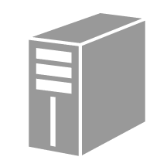
Apigee SmartDocs Overview
API Modeling
Describe an API structure
SmartDocs
Generate interactive documentation
API-based
Integrate with any portal / CMS
Apigee Edge Developer Services
Other CMS
gh-pages
Notes:
Main Points:
Edge Developer Services offers great modeling and documentation of API models functionality
Script:
API Modeling is a central service that holds the machine-structure of your API, and it uses that structure to organize all related metadata for your API.
The Smart doc generator takes that model and renders it into detailed API docs that developers need to be successful. Edge API Modeling and Smart docs are progressive – meaning that there is two way interaction between the model and the Smart doc and the API model continues to learn from updates made directly in the Smart doc too.

Slide 51
Fall 2014

